Slide 1
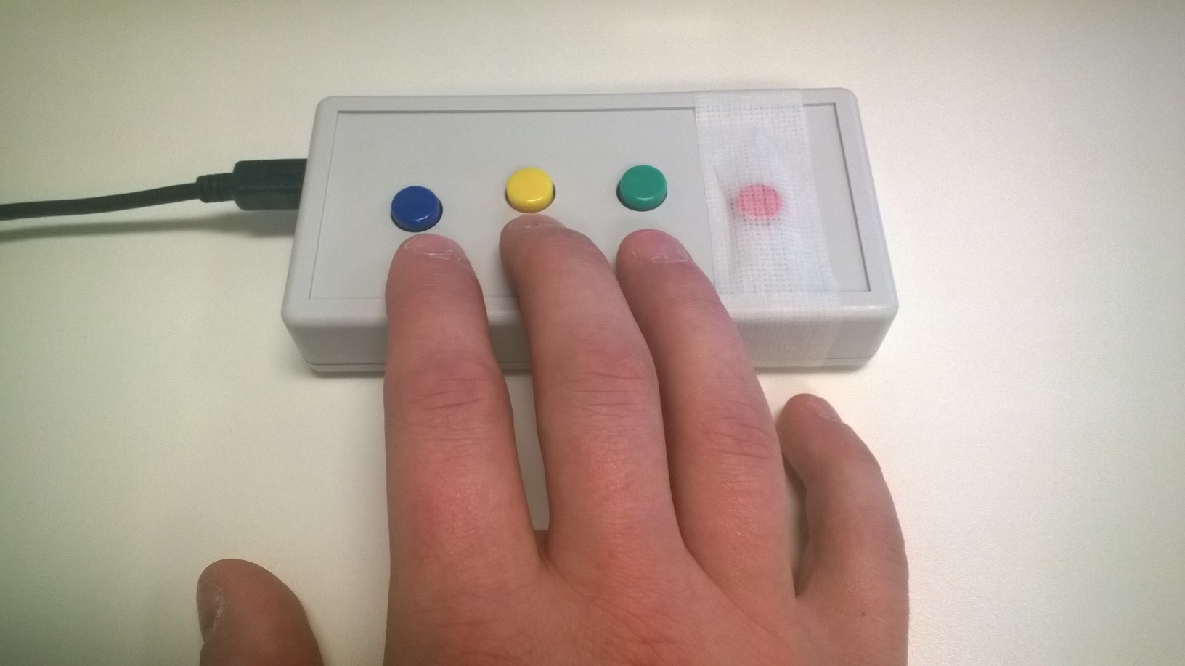
Practice Task
In the Response Box you have in your hand, each key represents a number starting from 1 under your index finger.
1
2
3
4
PRESS THE NUMBER 1 BUTTON TO CONTINUE
Notes:
Outside the scanner

Slide 2
During the fMRI Task, you need to use these keys in two different occasions.
1
2
3
4
PRESS THE NUMBER 2 BUTTON TO GO TO THE NEXT PAGE

Slide 3
To answer a question at the end of each series of pictures
To respond whenever you see a yellow frame around the pictures to show that you are carefully attending to the pictures
Now, please see the picture in the next page and answer to a question
1
2
3
4
PRESS THE NUMBER 3 BUTTON TO GO TO THE NEXT PAGE

Slide 4
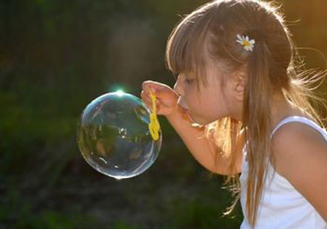
Notes:
Picture for 5 seconds

Slide 5
Now, answer to this question
Notes:
Question on Craving 1-4

Slide 6
Now, Please see following pictures and press number 1 (index finger) for any picture that has a yellow frame around it.

Slide 7
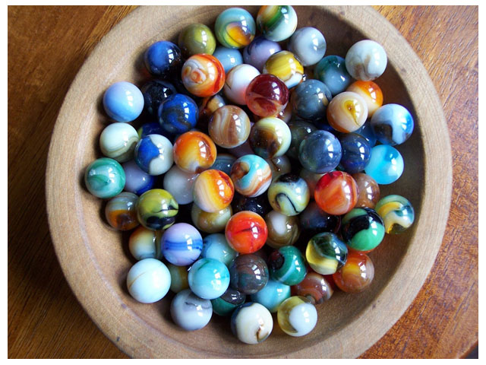
Notes:
Picture without frame

Slide 8
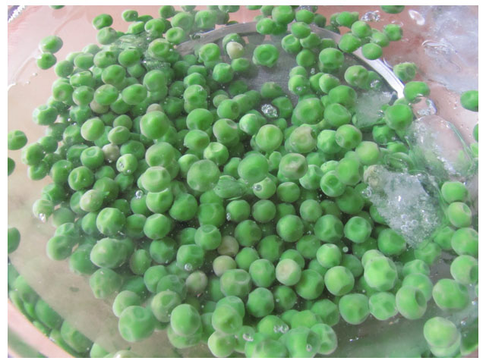
Notes:
Picture with frame

Slide 9
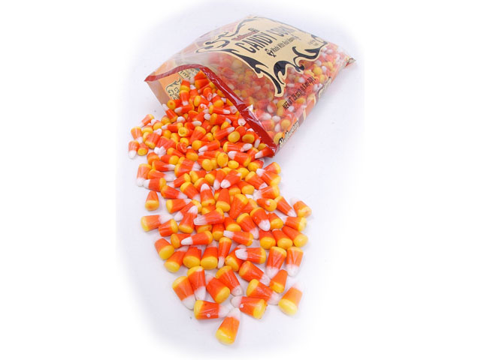
Notes:
Picture without frame

Slide 10
Great!
Now, you are ready to do the task inside the scanner.

